Slide 1
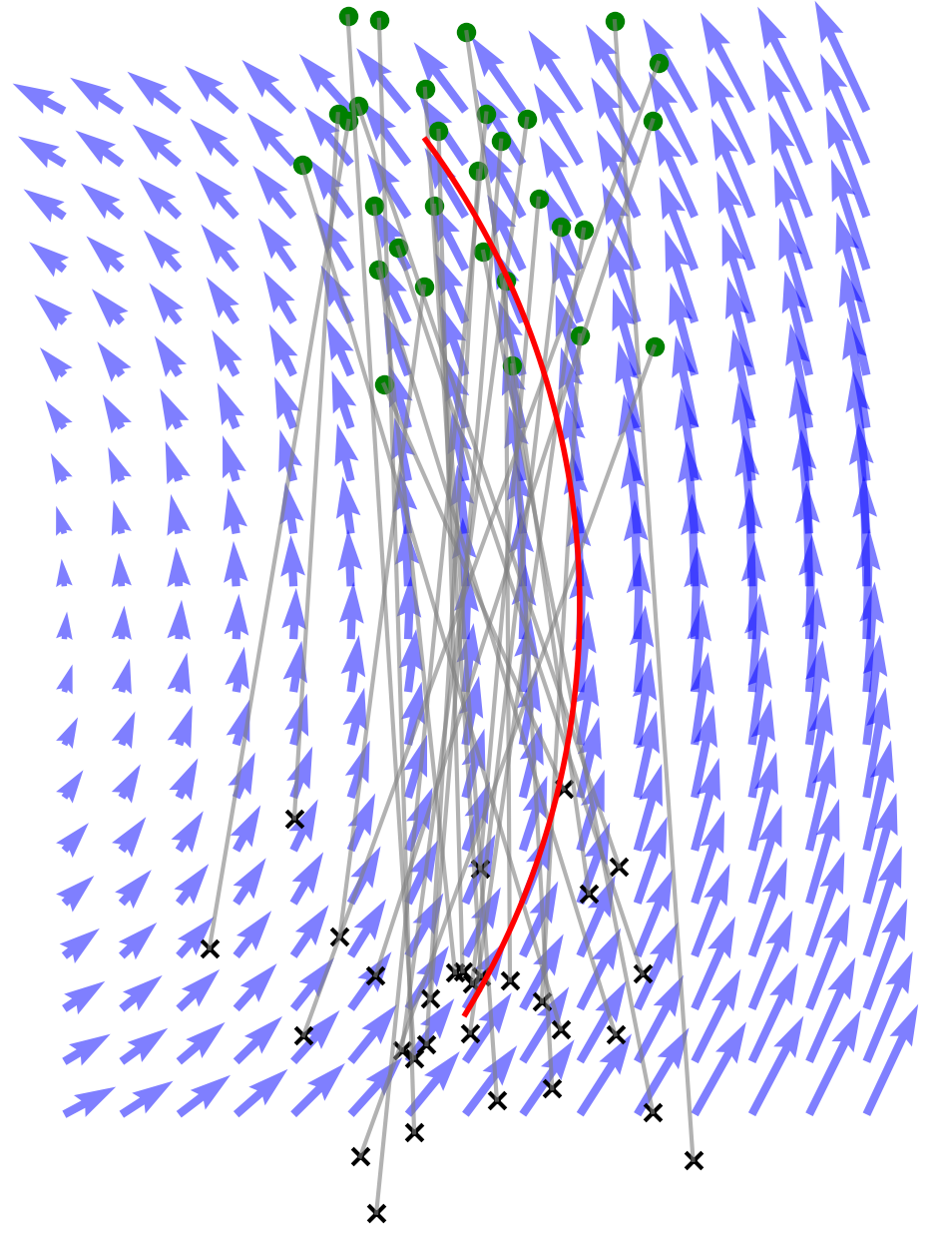
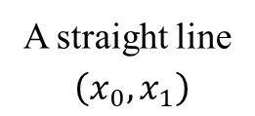


Vector field
$$x_{0}$$
$$x_{1}$$
A straight line
$\left(x_{0},x_{1}\right)$
ODE Trajectory

